Slide 1

Latest Management and Updates on TNBC
Canadian Breast Cancer Network Webinar
Presented by: Terry L. Ng, MD, FRCPC, Medical Oncologist on April 9, 2024
Faculté des sciences sociales | Faculty of Social Sciences
uOttawa.ca

Slide 2
Disclosures
2
Honoraria: ARIAD / Takeda Oncology, AstraZeneca Canada, Lilly
Advisory Roles: Boehringer Ingelheim, Novartis Canada, Knight Therapeutics, Gilead Sciences
Notes:
PAGE INTÉRIEURE
ÉBAUCHE (DOCUMENT NON FINALISÉ)
À lire avant d’utiliser le gabarit
NOTE : Les éléments du gabarit suivants ne peuvent être modifiés :
• Entête organisationnelle grenat (Université d’Ottawa | University of Ottawa)
• Pied de page organisationnel comprenant la bande grise et grenat ainsi que le logo, à l’exception de l’adresse Web qui peut être modifiée en suivant les étapes suivantes : dans le document PowerPoint, cliquez sur l’onglet View, puis sélectionnez Slide Master. Sur le menu d’affichage (à gauche), sélectionnez la troisième diapositive et inscrivez la nouvelle adresse sur celle-ci.
INSIDE PAGE
DRAFT ONLY (FILE NOT FINAL)
Read before using template
NOTE: The following elements of the template should remain untouched and cannot be modified:
• Corporate (Université d'Ottawa | University of Ottawa) garnet header
• Corporate uOttawa footer including the grey/garnet stripe and logo, with the exception of the URL which can be customized to a specific URL by following these simple steps: On the PowerPoint View tab, in the Master Views group, select Slide Master. Select the third slide on the left side panel, and type in the desired URL on the slide.

Slide 3
Disclaimer
The information presented today reflects my biases and interpretation of the data
There is too much data out there. I will only cover what I think are the most impactful for patients today.

Slide 4
Objectives
To provide guiding principles on the management of early and metastatic TNBC
To provide information from practice-changing clinical trial data for patients with TNBC

Slide 5
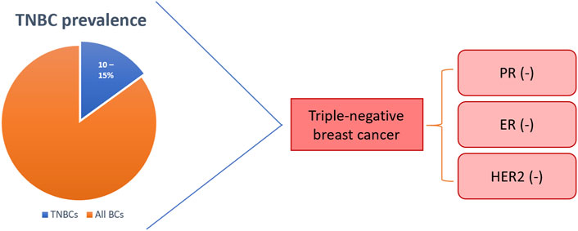
TNBC prevalence and definition
Green-Tripp G et al. Front Mol Biosci. 2022

Slide 6
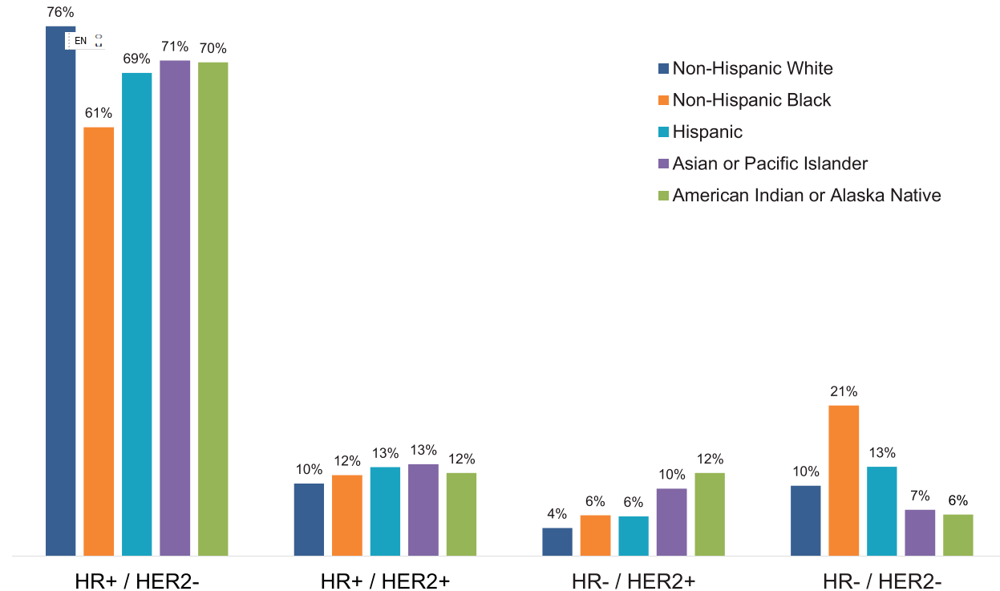
Distribution of breast cancer subtypes and ethnicity
Howard FM & Olopade OI. The CA Journal. 2021

Slide 7
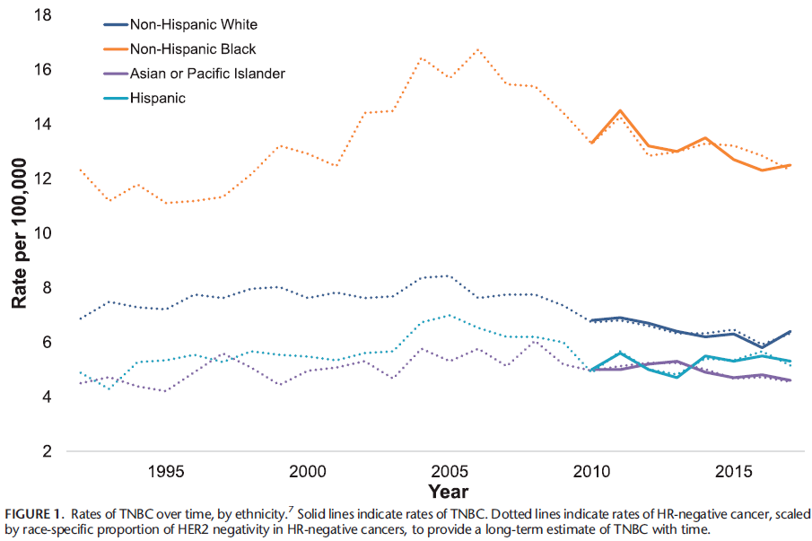
Race-based incidence rates of TNBC
Howard FM & Olopade OI. The CA Journal. 2021

Slide 8
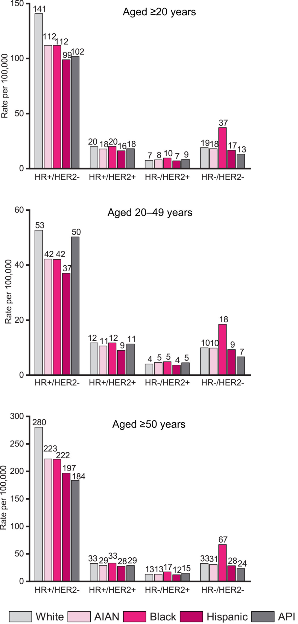
Age distribution of TNBC
CA A Cancer J Clinicians, Volume: 72, Issue: 6, Pages: 524-541, First published: 03 October 2022, DOI: (10.3322/caac.21754)

Slide 9
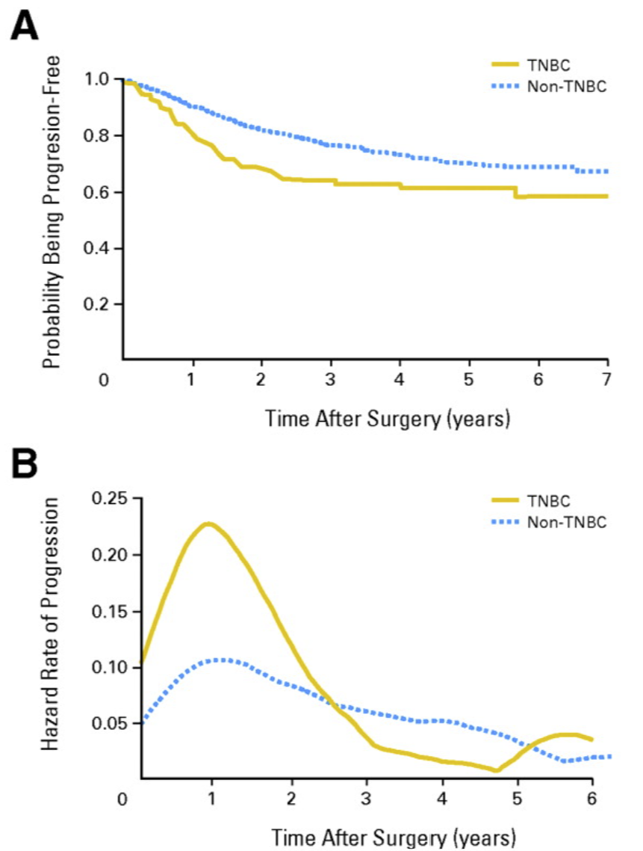
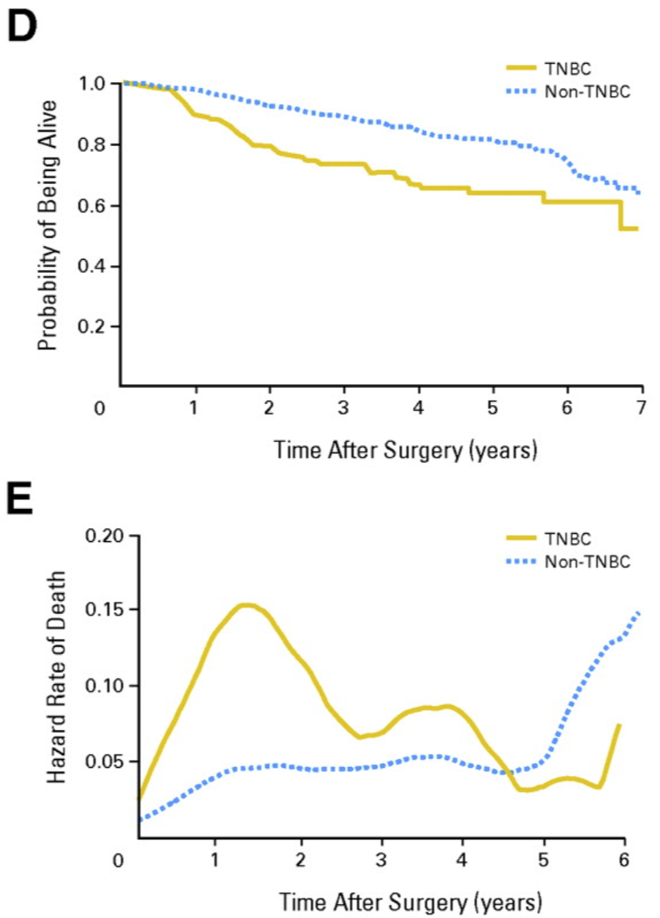
Survival trends TNBC vs. non-TNBC
Liedtke C et al. J Clin Oncol 2018

Slide 10
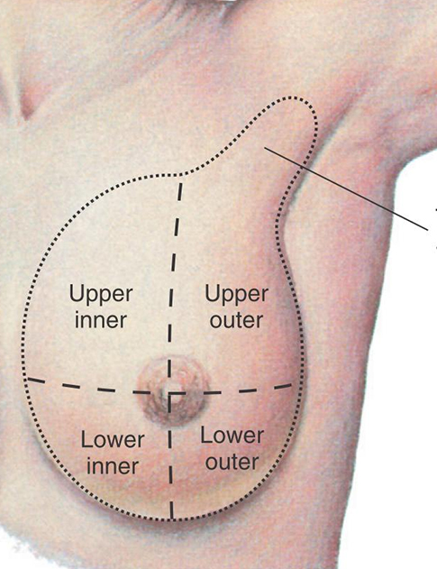
Case 1
Ms. Smith
38 F, pre-menopausal
Detected mass in left breast
Mammogram showed a 3 cm mass in left breast, upper-outer quadrant and enlarged LN in left axilla (armpit)
Ultrasound-guided biopsy breast mass and axilla mass:
  Both show invasive ductal carcinoma, high grade
  ER negative
  PR negative
  HER-2/neu negative

Slide 11
Case 1
Surgeon sends patient to medical and radiation oncologist for consideration of “neoadjuvant therapy”
Neoadjuvant therapy
Chemotherapy
Surgery
Adjuvant therapy
Surgery
Chemotherapy
For the longest time, neoadjuvant and adjuvant therapy were both considered comparable for survival outcomes…

Slide 12
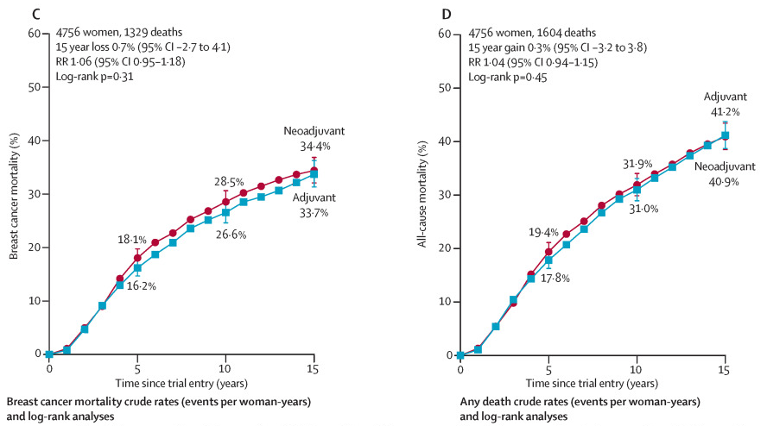
Neoadjuvant vs. Adjuvant treatment outcomes
No difference in breast cancer related deaths or death from any cause
EBCTCG. Lancet Oncol. Jan 2018

Slide 13
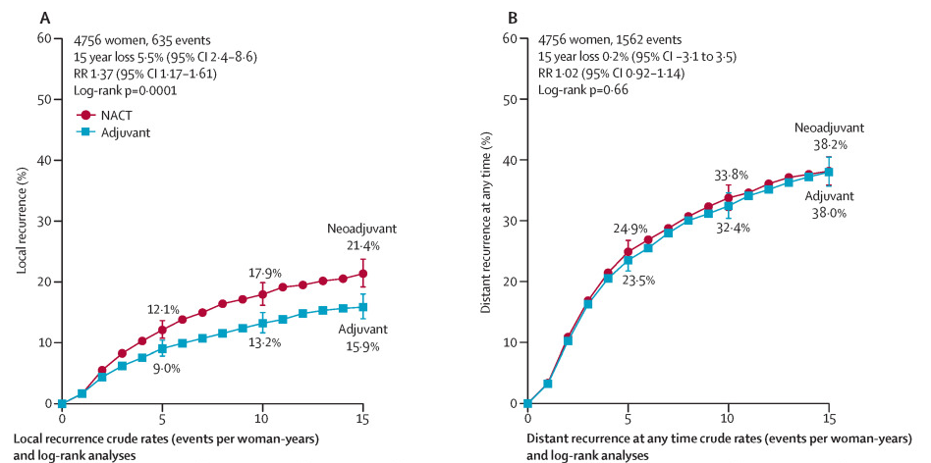
Neoadjuvant vs. Adjuvant treatment outcomes
No difference in distant disease recurrence, but higher local recurrence w/ neoadjuvant chemo
EBCTCG. Lancet Oncol. Jan 2018

Slide 14
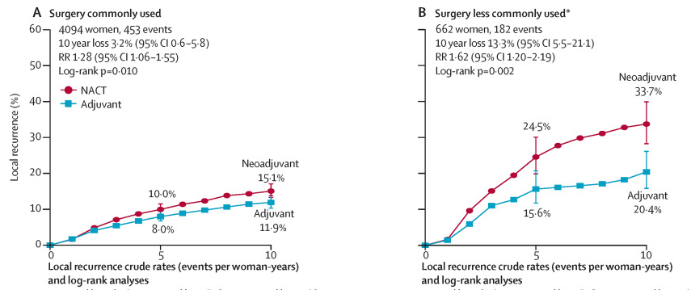
Neoadjuvant vs. Adjuvant treatment outcomes
Differences in rate of local disease recurrence driven by trials with fewer definitive breast surgery
EBCTCG. Lancet Oncol. Jan 2018

Slide 15
What is role of neoadjuvant therapy?
Make an unresectable tumour → resectable
  Examples: fixed to chest wall or fixed lymph node mass
Increase the chance of being able to do lumpectomy instead of mastectomy
Potentially allow the avoidance of axilla lymph node dissection (ALND)
Assess cancer response to neoadjuvant therapy
  Did we achieve a pathologic complete response (pCR)?

Slide 16
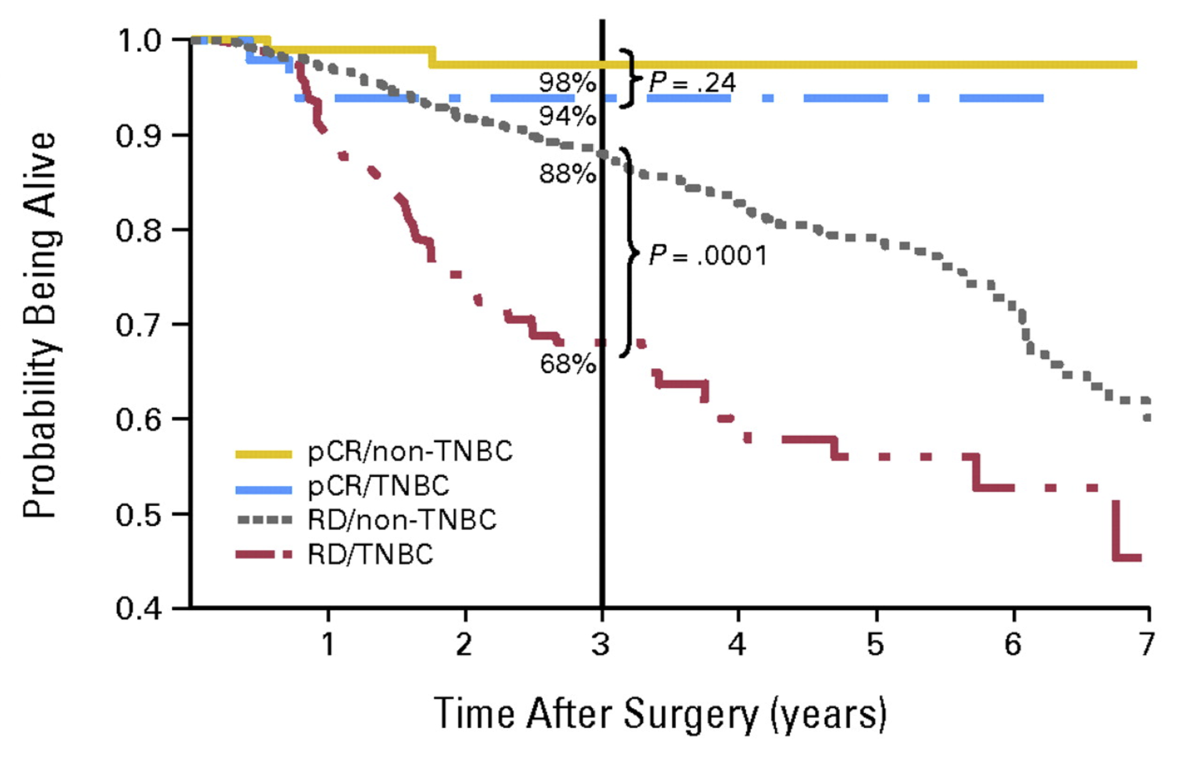
Survival based on pCR
TNBC vs. non-TNBC
Liedtke C et al. J Clin Oncol 2018

Slide 17
Case 1
Surgeon sends patient to medical oncologist for consideration of “neoadjuvant therapy”
Neoadjuvant therapy
pCR
Good outcome
Chemotherapy
Surgery
non
pCR
Higher risk
Anthracycline + Taxane +/- carboplatin
Example: Dose-dense AC x 4 → dose-dense paclitaxel x 4
pCR = pathologic complete response
Non-pCR = residual disease in breast specimen after neoadjuvant chemo
Notes:
Neoadjuvant approach was previously reserved in cases of locally-advanced disease or where we wanted to maximize chance of breast-sparing surgery

Slide 18
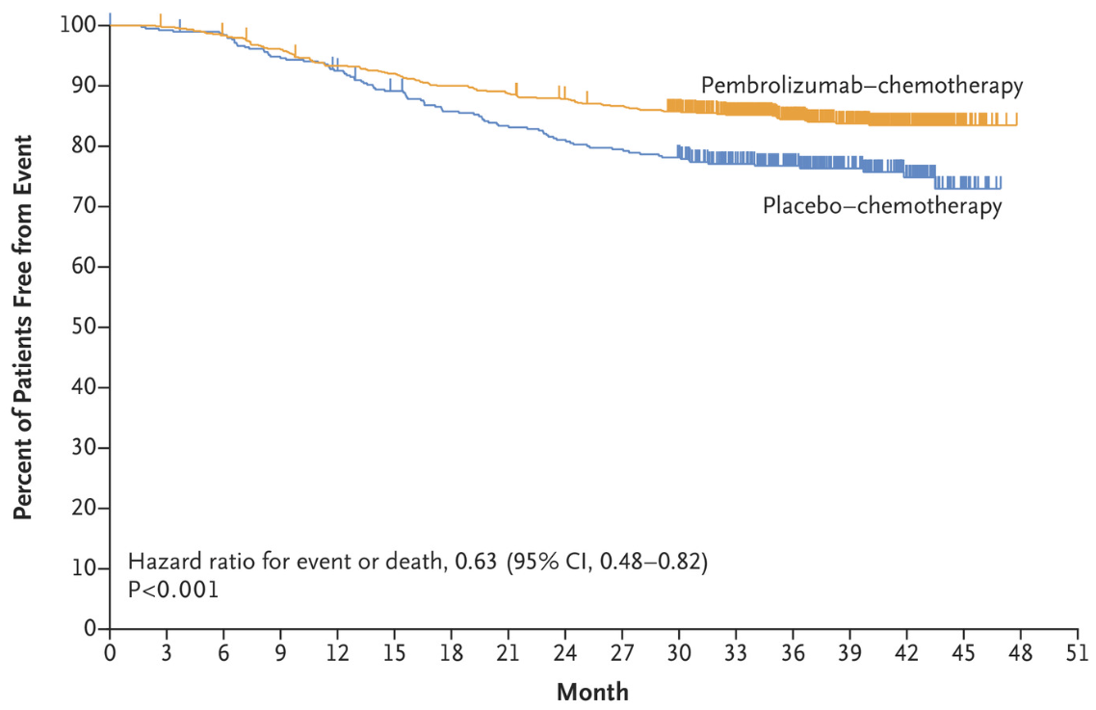
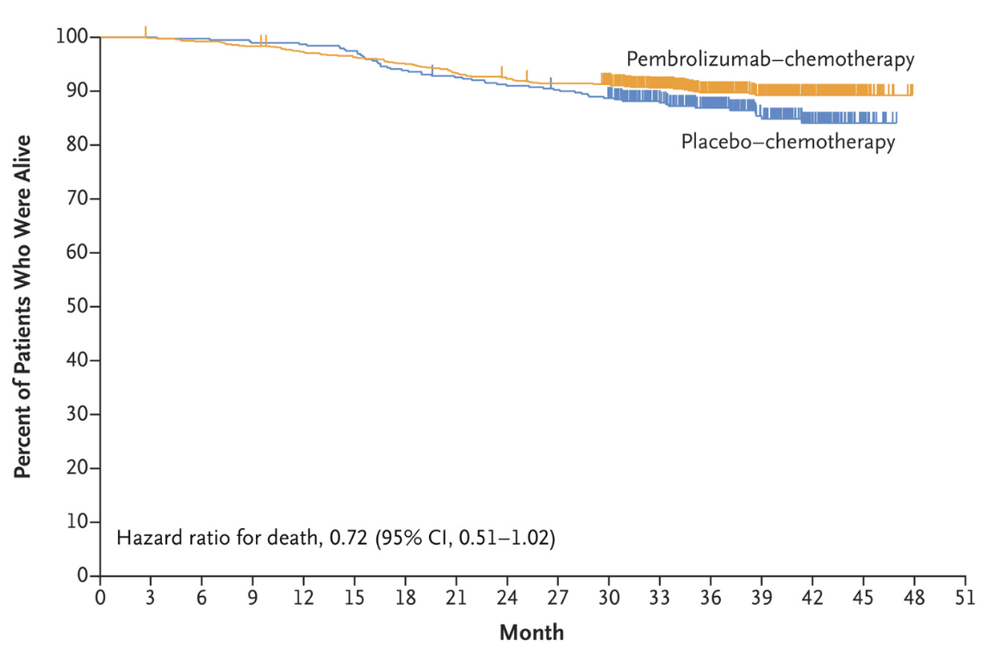
2022 standard (Keynote 522):
Adding immunotherapy to chemotherapy in stage II/III TNBC
Pembrolizumab
+
Chemotherapy
Surgery
Continue pembrolizumab x 6 mo
Disease-free survival
Overall survival
Schmid P et al. NEJM. Feb 2022

Slide 19
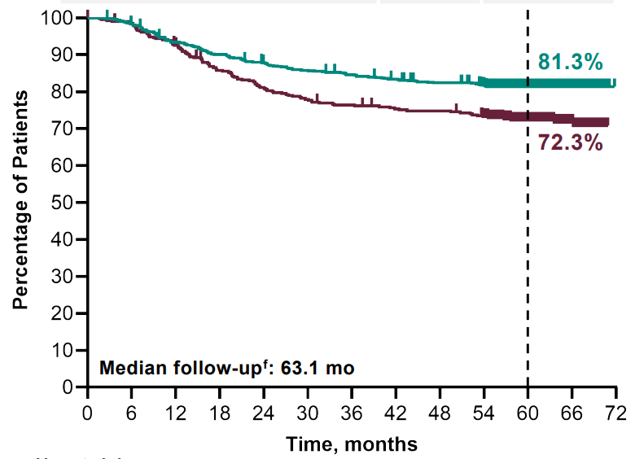
Adding immunotherapy to chemotherapy (Keynote 522): 5-year event-free survival
Pembrolizumab
+
Chemotherapy
Surgery
Continue pembrolizumab x 6 mo
5-yr Disease-free survival
Schmid et al. SABCS 2023 LBO1-01

Slide 20
Case 1 – Scenario 1 – best case scenario
Ms. Smith’s medical oncologist recommends chemo plus immunotherapy (pembro) before surgery based on Keynote 522 results
After chemo-immunotherapy, she undergoes successful lumpectomy and sentinel lymph node biopsy
“No residual invasive cancer in breast tissue or sampled lymph nodes – ypT0, ypN0” = pCR!!
Pembrolizumab
+
Chemotherapy
pCR
Surgery
Continue pembrolizumab x 6 mo

Slide 21
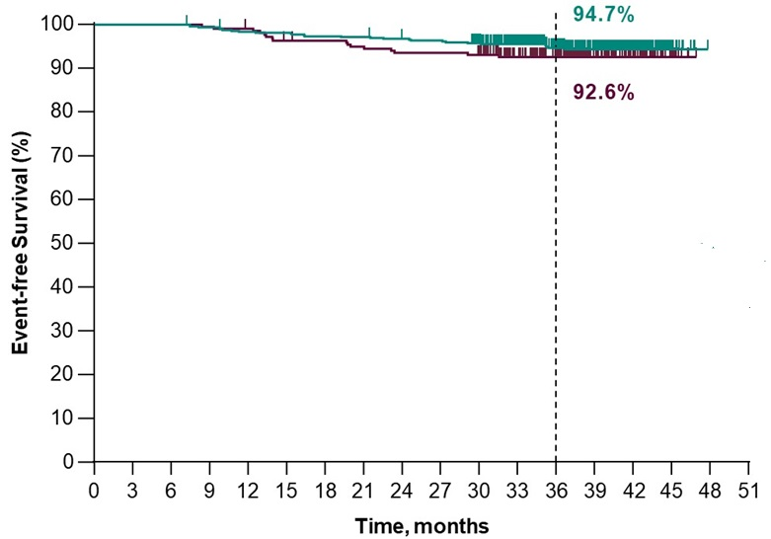
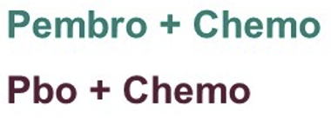
Case 1 – Scenario 1
Historically, pCR = good long-term outcome (remember few slides ago)
KN522 study: In pCR group, minimal difference in disease-free (event-free) survival with the addition of pembrolizumab
Pusztai L et al. ASCO 2022 – Abstr 503

Slide 22
Do we need pembrolizumab after surgery if pCR?
OPTIMICE-pCR (NCT 05812807) – ongoing enrollment
Pembrolizumab x 6 mo
Pembrolizumab
+
Chemotherapy
Surgery
pCR
Observation

Slide 23
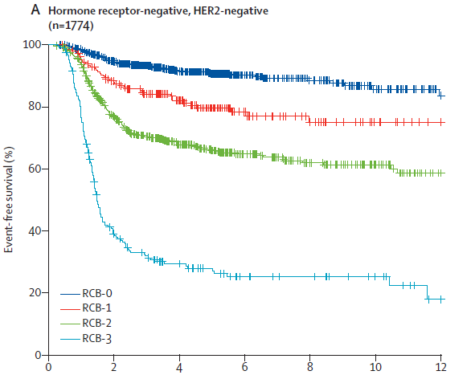
Residual cancer burden (RCB) is highly prognostic in TNBC
RCB-0
RCB-1
RCB-2
RCB-3
Yau C et al. Lancet Oncol Jan 2022

Slide 24
Case 1 – Scenario 2
After chemo-immunotherapy (per KN522), Ms. Smith underwent breast surgery
“Residual 2.5 cm focus of grade 3 invasive carcinoma in breast tissue (70% tumor cellularity) + 3 out of 3 lymph nodes with metastatic carcinoma, largest focus 25 mm)
ypT2, ypN1a, Residual Cancer Burden (RCB)-3 = non-pCR!
Pembrolizumab
+
Chemotherapy
Non- pCR
Surgery
What next after surgery???

Slide 25
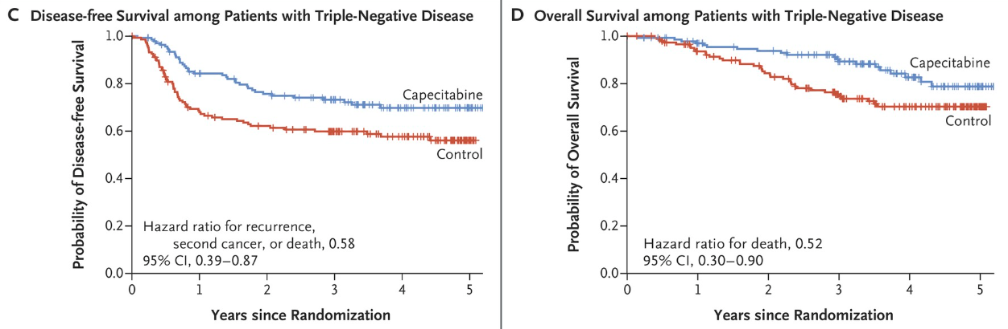
CREATE-X study (published before KN522):
More chemo if residual disease (non-pCR)
Capecitabine x 6 mo
non
pCR
Chemotherapy
Surgery
Control
Masuda N et al. NEJM. June 2017

Slide 26
Keynote 522 did not allow combining pembrolizumab w/ capecitabine after surgery
KN522 experimental treatment arm
Pembrolizumab
+
Chemotherapy
Surgery
Non-pCR
Continue pembrolizumab x 6 mo
Capecitabine not allowed in KN522 even if non-pCR
If non-pCR: Should we combine capecitabine + pembrolizumab?
Drug access for the combination is an issue in some provinces
Schmid et al. SABCS 2023 LBO1-01

Slide 27
Case 1 – Scenario 2
After chemo-immunotherapy (per KN522), Ms. Smith underwent breast surgery
“Residual 2.5 cm focus of grade 3 invasive carcinoma in breast tissue (70% tumor cellularity) + 3 out of 3 lymph nodes with metastatic carcinoma, largest focus 25 mm)
ypT2, ypN1a, RCB-3
Not routinely funded
Pembrolizumab +/- capecitabine is (KN522 + CREATE-X)
Pembrolizumab alone (KN522)
Capecitabine alone (CREATE-X)
Clinical trial
Pembrolizumab
+
Chemotherapy
Non- pCR
Surgery

Slide 28
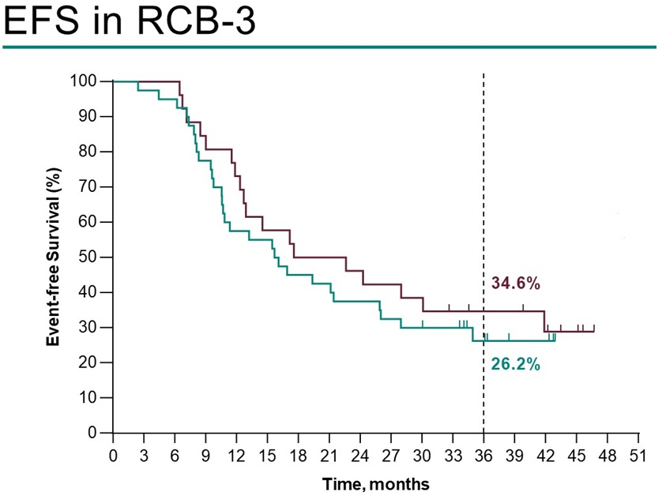

Case 1 – Scenario 2
Received 5 weeks of radiation to breast and regional lymph nodes
After surgery, started oral capecitabine chemotherapy for 6 months AND continued pembrolizumab (private insurance)
(Keynote 522)
Pusztai L et al. ASCO 2022 – Abstr 503

Slide 29
How important is immunotherapy given after surgery?
We don’t really know yet, but here are a few studies…

Slide 30
Is giving adjuvant pembrolizumab useful in non-pCR if not given pre-surgery?
S1418 / BR006 (closed to accrual, no results yet):
Pembrolizumab x 1 yr
Non- pCR
Chemotherapy
Surgery
Observation
Ignatiadis M et al. SABCS 2023: GS01-03

Slide 31
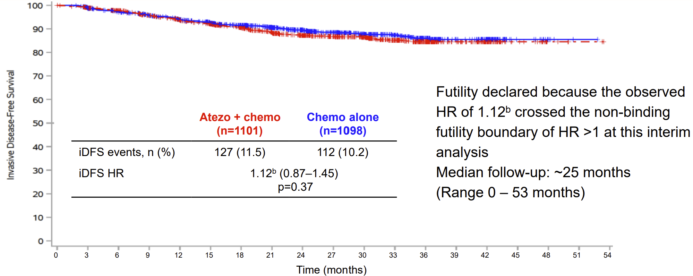
Adjuvant atezolizumab (immunotherapy) after surgery NOT USEFUL if only given AFTER breast tumour removed
ALEXANDRA / IMpassion030 phase 3 trial
Atezolizumab
+
Chemotherapy
Surgery
Atezolizumab x 6 mo
Ignatiadis M et al. SABCS 2023: GS01-03

Slide 32
Case 1 – Scenario 3
During chemo-immunotherapy (per KN522), Ms. Smith’s genetic blood test came back showing BRCA 1 pathogenic variant
Removal of both breasts (bilateral mastectomy) and sentinel lymph node biopsy left axilla after neoadjuvant therapy
ypT1c, ypN1a – RCB-2
Pembrolizumab +/- capecitabine x 6 mo
Clinical trial
Olaparib x 1 year
Pembrolizumab
+
Chemotherapy
Non- pCR
Surgery
Patients w/ germline BRCA ½ pathogenic variant who have residual disease despite neoadjuvant therapy benefit from Olaparib based on OlympiA study

Slide 33
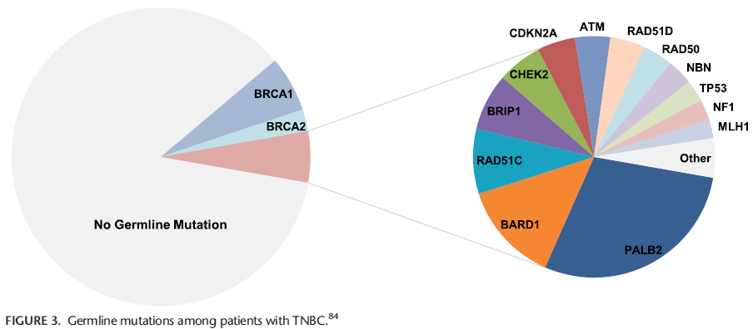
Known germline mutations associated with TNBC
Howard FM & Olopade OI. The CA Journal. 2021

Slide 34
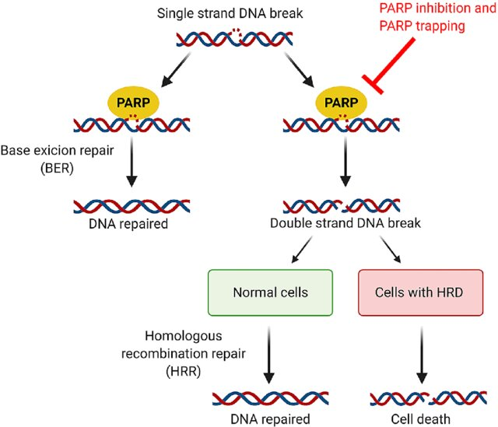
PARP inhibitors in Homologous Recombination Repair Deficiency (e.g., gBRCA mutation)
Bruin M et al. Clin Pharmacokinetics. 2022; 61(13). License CC BY-NC 4.0

Slide 35
OlympiA: Trial Schema
Neoadjuvant group
TNBC: Non-pCR
Olaparib 300 mg twice daily
for 1 year
Germline BRCA ½ mutation
TNBC
and
HER2-
1:1
Randomization
Adjuvant group
TNBC: ≥ pT2 or ≥ pN1
Placebo
twice daily
for 1 year
Tutt A et al. ASCO 2021. LBA-1

Slide 36
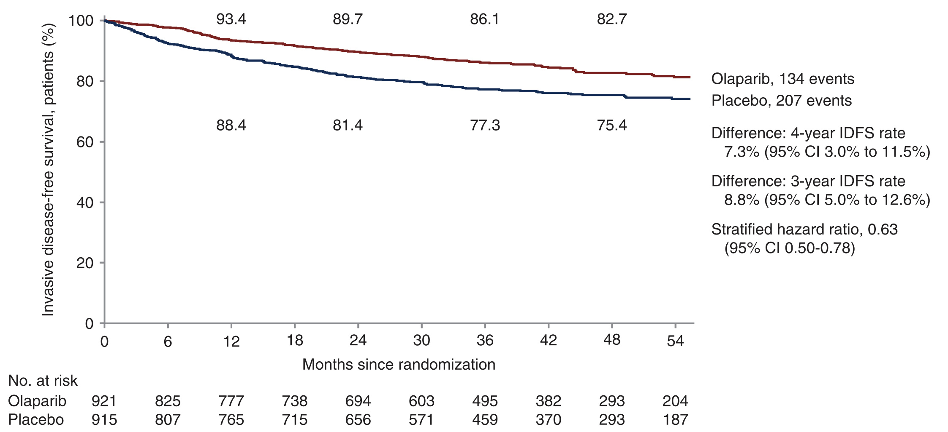
OlympiA trial:
Invasive disease-free survival
Tutt A et al. ASCO 2021. LBA-1

Slide 37
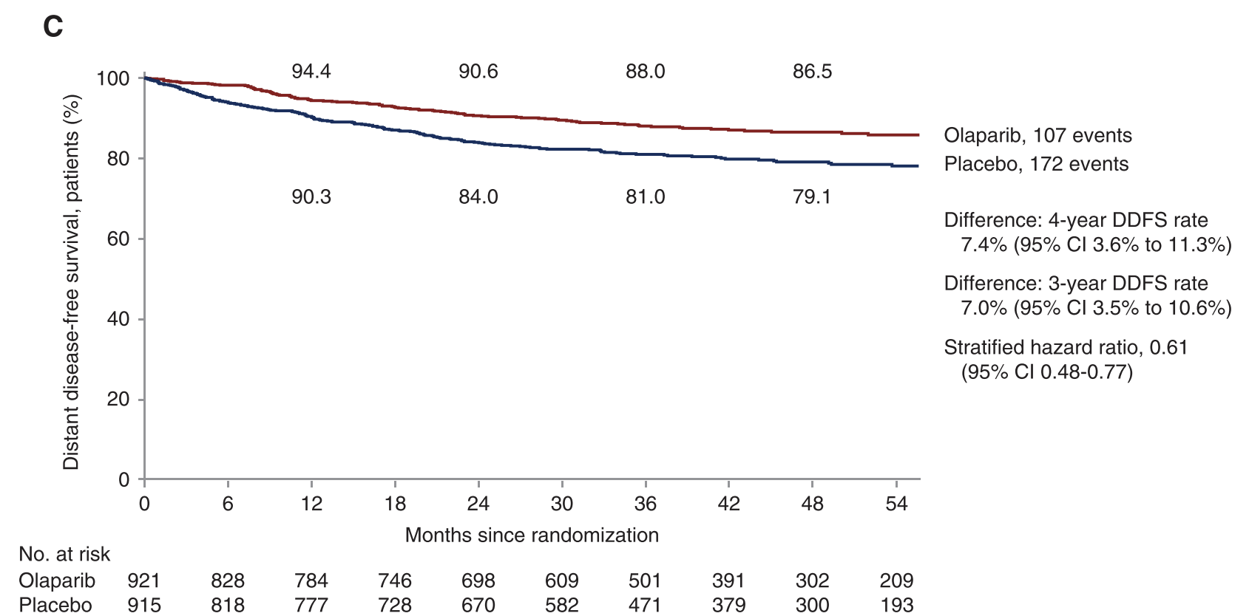
OlympiA trial:
Distant disease-free survival
Tutt A et al. ASCO 2021. LBA-1

Slide 38
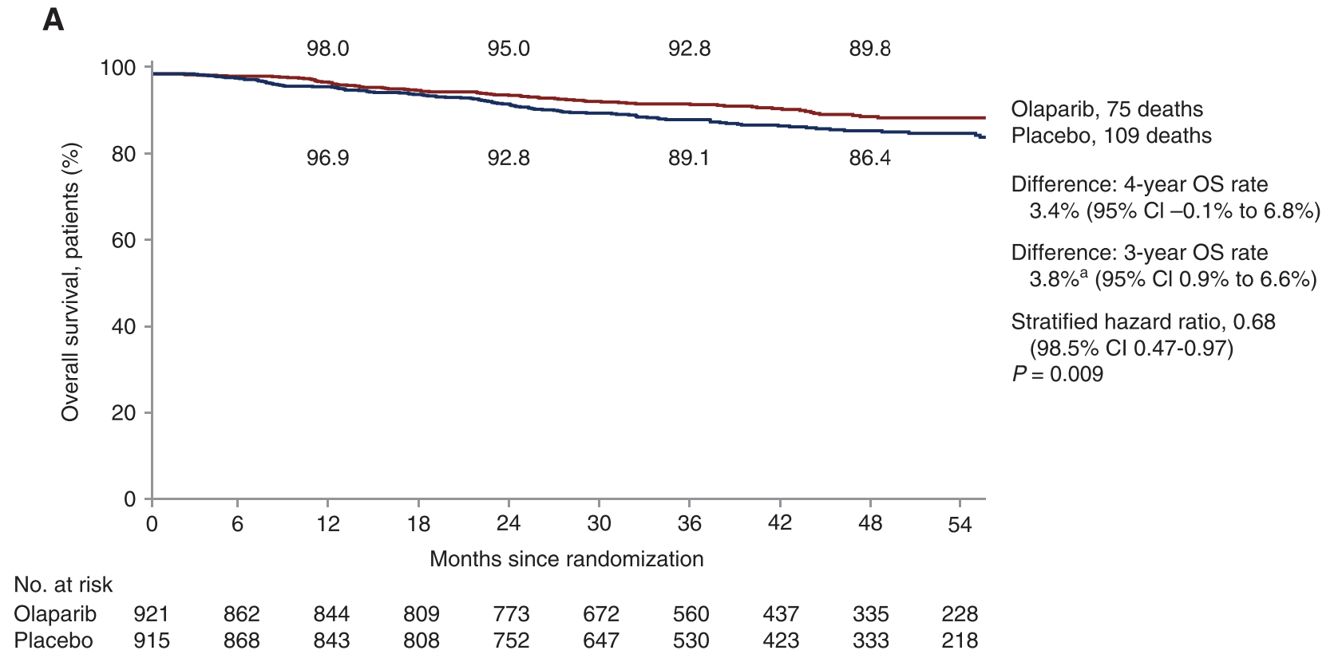
OlympiA trial:
Overall survival
Tutt A et al. ASCO 2021. LBA-1

Slide 39
Treatment algorithm for early TNBC so far…
Olaparib if gBRCA+ AND high risk
No role for capecitabine
No role for pembrolizumab
Surgery
Chemotherapy
Do we need pembro in pCR?
pCR
Pembrolizumab x 6 mo
Pembrolizumab
+
Chemotherapy
Surgery
Pembrolizumab +/- capecitabine x 6 mo
Capecitabine x 6 mo
Olaparib x 1 yr (if gBRCA+)
Clinical trial
non
pCR

Slide 40
Optimizing current standard of care (SOC) for early-stage TNBC
OptimICE: Can we stop pembrolizumab if pCR?
CAPPA: Does adding capecitabine to pembrolizumab improve outcomes if non-pCR? (not yet recruiting)
ETNA: In small tumors + surgical resection up front, can we omit chemotherapy in patients with good prognosis (high TILs)?
TROPION-Breast04: Replacing standard neoadjuvant chemo-pembrolizumab with Dato-Dxd + durvalumab → adjuvant durvalumab +/- SOC chemo

Slide 41
Improving outcomes of non-pCR patients
Non- pCR
Chemotherapy
Surgery
Clinical trial
BreastImmune03: RT + nivolumab + ipilimumab (combo-immunotx) vs. RT + capecitabine
TROPION-Breast03: Dato-Dxd +/- durvalumab vs. physician’s choice (pembrolizumab vs. capecitabine vs. pembrolizumab + capecitabine)
ASCENT-05: Sacituzumab govitecan + pembrolizumab vs. physician’s choice (pembrolizumab +/- capecitabine)

Slide 42
Other optimizations for early TNBC – Dose-dense anthracycline anyone?
Chemotherapy
Surgery
AC every 2 weeks (Q2W) x 4 → Paclitaxel (P) weekly (Q1W) x 12
BETTER THAN
AC Q3W x 4 → Paclitaxel Q1W x 12
But KEYNOTE 522 uses
Paclitaxel + carboplatin Q1W/Q3W x 4→ AC Q3W x 4
PLUS pembrolizumab Q3W
Surgery
Citron ML et al. J Clin Oncol 2003

Slide 43
Other optimizations for early TNBC – Dose-dense (Q2W) anthracycline
KEYNOTE 522 chemo regimen
Paclitaxel + carboplatin Q1W/Q3W x 4 + Pembro Q3W →
AC Q3W x 4 + Pembro 200 mg Q3W
Paclitaxel + carboplatin Q1W/Q3W x 4 + Pembro Q3W →
AC Q2W x 4 + Pembro 400 mg Q6W*
Surgery
  *Can give anthracyclines dose-dense (Q2W) by giving pembrolizumab Q6W instead
Citron ML et al. J Clin Oncol 2003

Slide 44
Other optimizations for early TNBC – When is carboplatin required?
Paclitaxel + carboplatin x 4 + Pembrolizumab →
AC x 4 + Pembrolizumab
Unclear who needs carboplatin
  Carboplatin improved overall survival in age ≤50 in India in high-risk, mostly stage III TNBC (Tata Memorial TNBC phase III study)¹
  May not need carboplatin in chemo-sensitive subtypes like germline BRCA mutation, high TILs²⁻⁷
  We are routinely giving carboplatin because that was built into Keynote 522 regimen
Gupta S et al. SABCS 2022. Abstract GS5-01
von Minckwitz G et al. GeparSixto; GBG 66. Lancet Oncol 2014;15:747-56.
Sikov WM et al. CALGB 40603 (Alliance). J Clin Oncol 2015;33:13-21.
Loibl S et al. BrighTNess. Lancet Oncol 2018;19:497-509.
Hahnen E, Lederer B, Hauke J, et al. JAMA Oncol 2017;3:1378-85
Tung N et al. TBCRC 031 (the INFORM trial). J Clin Oncol 2020;38:1539-48
Poggio F et al. Ann of Oncol. 2018. 29: 1497-1508

Slide 45
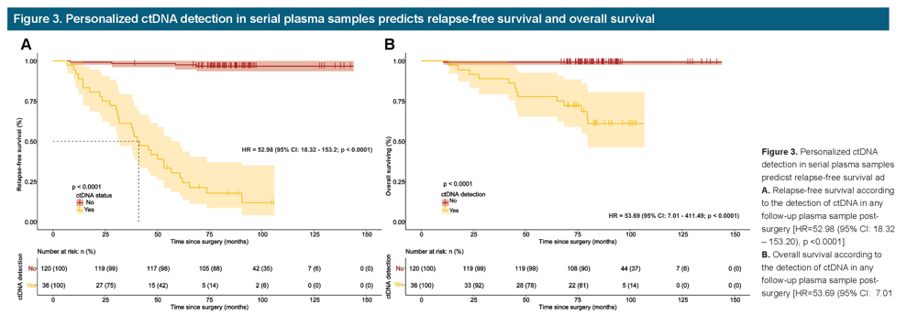
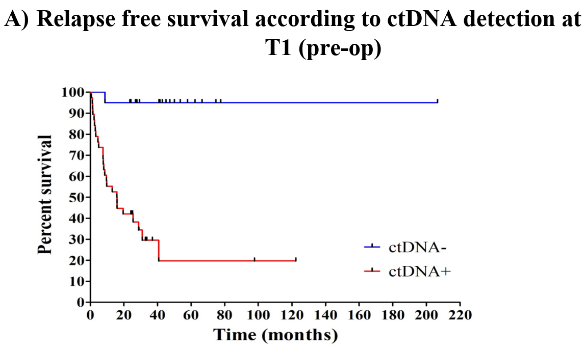
Beyond pCR: Circulating tumor DNA (ctDNA) to improve prediction of outcomes
7/23 TNBC who relapsed had at least one ctDNA+ sample
59 TNBC pts had ctDNA sample pre-surgery
HR=0.17 (95% CI = 0.08 to 0.36; p<0.0001)
Relapse free survival based on ctDNA detection serial sample collection after surgery
Relapse free survival based on ctDNA detection pre-surgery
Shaw JA et al. ASCO 2022. Abs 562
Rosheshter T et al. CCRA 2023

Slide 46
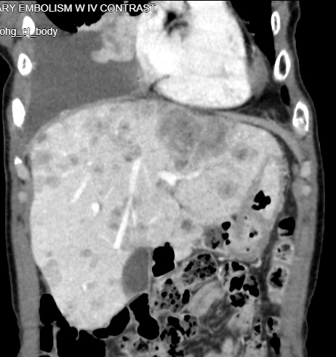
Case 2 – Metastatic TNBC (mTNBC) recurrence (no prior PD-L1 / pembro)
In Dec 2019, Mrs. Jones (60 F) was treated with neoadjuvant chemo (without pembrolizumab) → surgery (RCB-2) → 6 months of capecitabine
In Dec 2022, reported:
  ↑ fatigue + ↓ appetite for 4 months
  ↑ difficulty breathing and chest discomfort for 1 month
CT scan shows fluid in right lung and extensive number of lesions in liver
Biopsy of liver tumor shows:
  Grade 3 invasive ductal carcinoma
  ER-, PR-, HER2-

Slide 47
Case 2 – mTNBC 1L treatment
PD-L1 testing on the liver biopsy: 15%
Medical oncologist proposes pembrolizumab plus paclitaxel chemotherapy
De novo mTNBC
Recurrence ≥ 6 mo after completing curative tx
No prior PD-L1 tx allowed
Pembrolizumab + chemotherapy
R
2:1
Placebo + chemotherapy
KEYNOTE-355 study
Rugo H et al. ESMO 2021

Slide 48
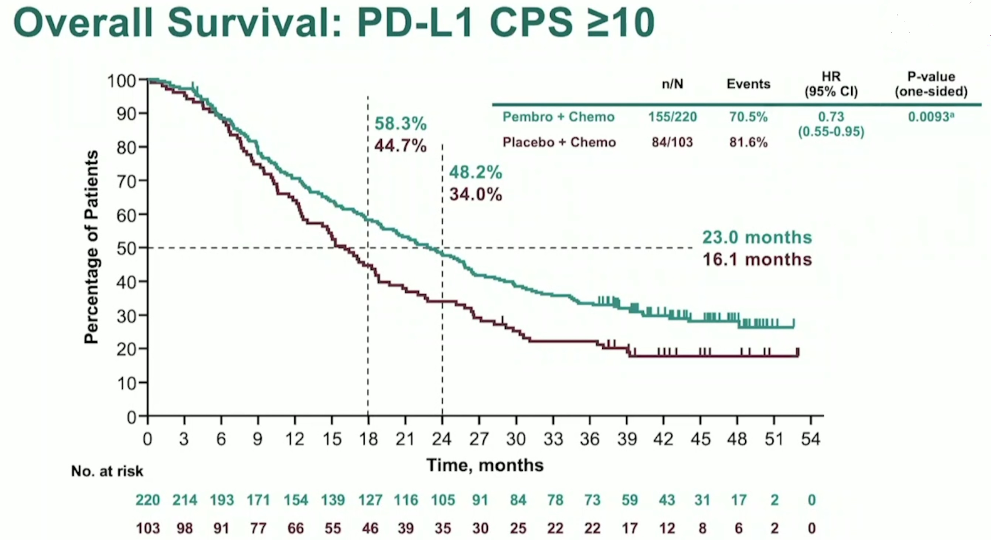
KEYNOTE-355 – First line (1L) for mTNBC
ORR 52.7%
ORR 40.8%

Slide 49
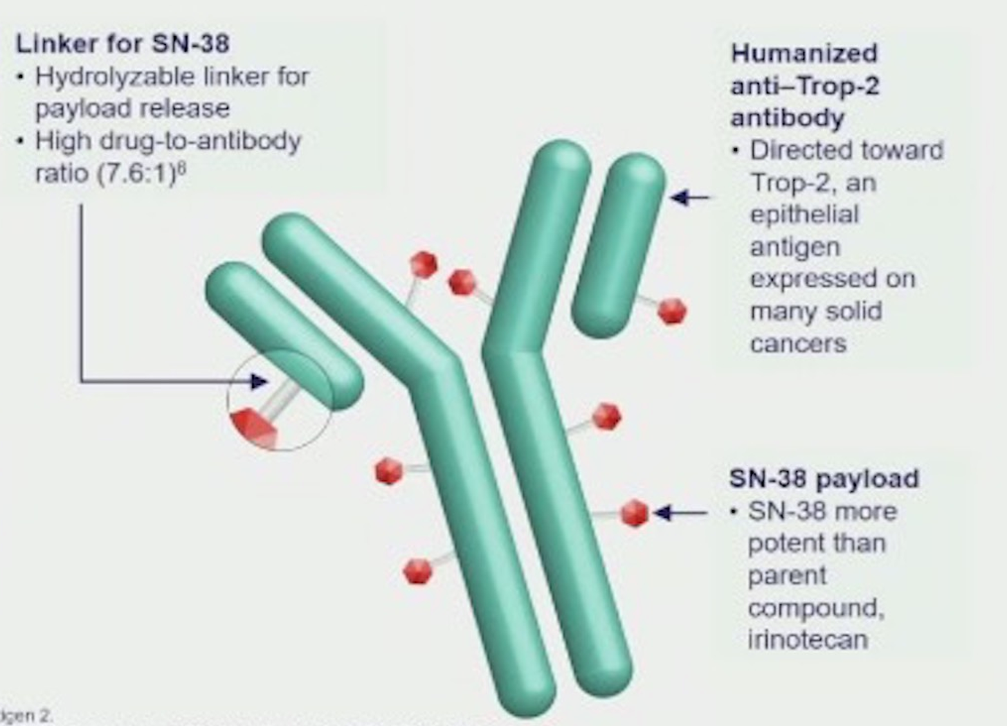
Case 2 - Progressed on 1L treatment
Mrs. Jones had improvement in symptoms on pembrolizumab + paclitaxel for 8 months until developed new and growing liver metastases
Sacituzumab govitecan recommended

Slide 50
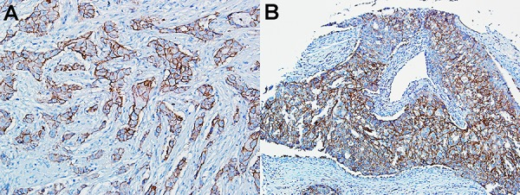
Trop-2 as a target in TNBC
Trop-2 Expression in Patients with TNBC (N=48)
Strong (3+) Trop-2 expression in two TNBC specimens within a tumor microarray²
4%
None
IHC 0
8%
Weak
IHC 1
96%
Trop2 overexpressed
88%
Moderate to Strong
IHC 2+ to 3+
High Trop-2 overexpression rate with predominantly moderate to strong intensity of IHC staining
suggests that pretherapy biomarker assessment for TNBC patient selection is not required.

Slide 51
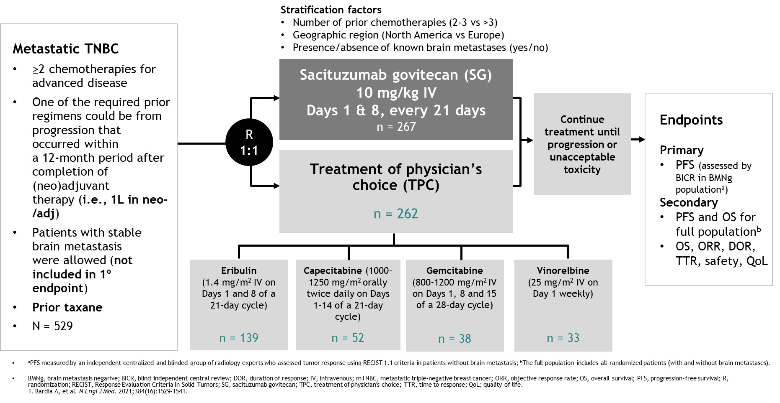
ASCENT – 2L+ for mTNBC

Slide 52
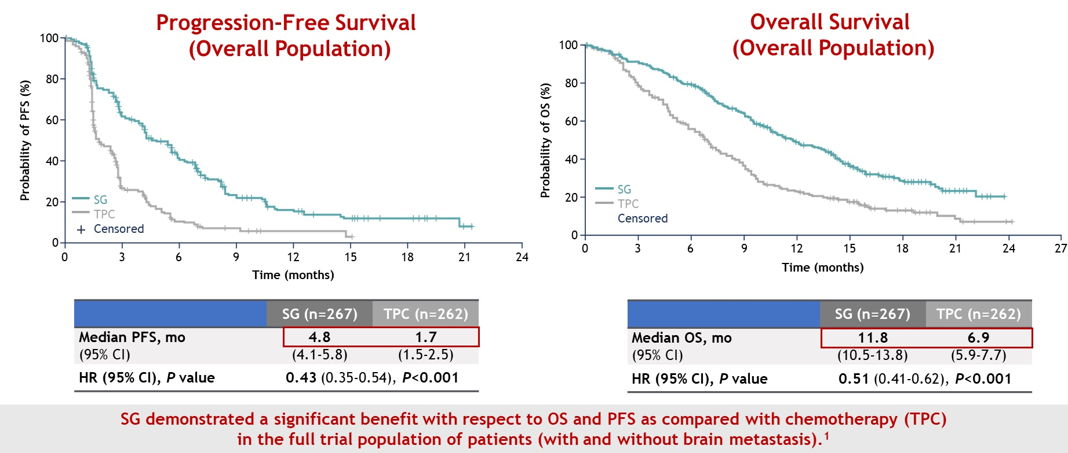
ASCENT – 2L+ for mTNBC
Tumor Response: 35% vs 5%

Slide 53
Case 2 - Progressed on 2L treatment
Mrs. Jones had stable disease on Sacituzumab-govi for 6 months.
She had some fatigue and diarrhea on treatment, but they were manageable
Unfortunately, more and growing liver metastases after 6 months
Her oncologist proposed a phase 1 clinical trial of a new antibody-drug conjugate – Dato-Dxd

Slide 54
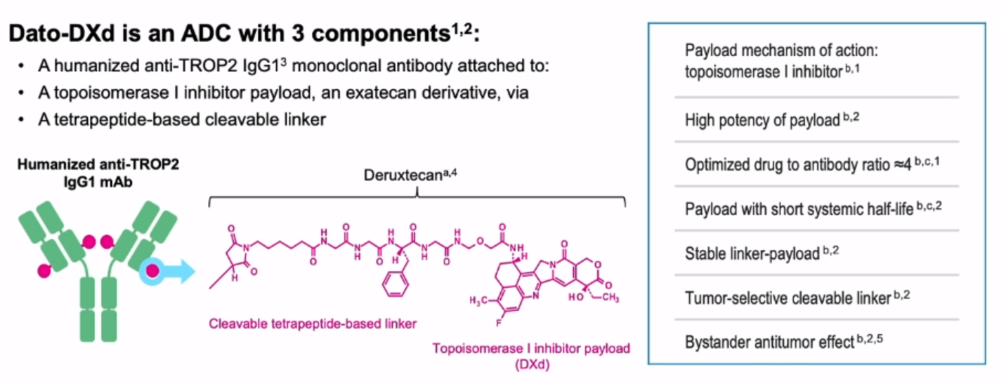
Case 2 – Novel treatment option after 2L (still in clinical trials)

Slide 55
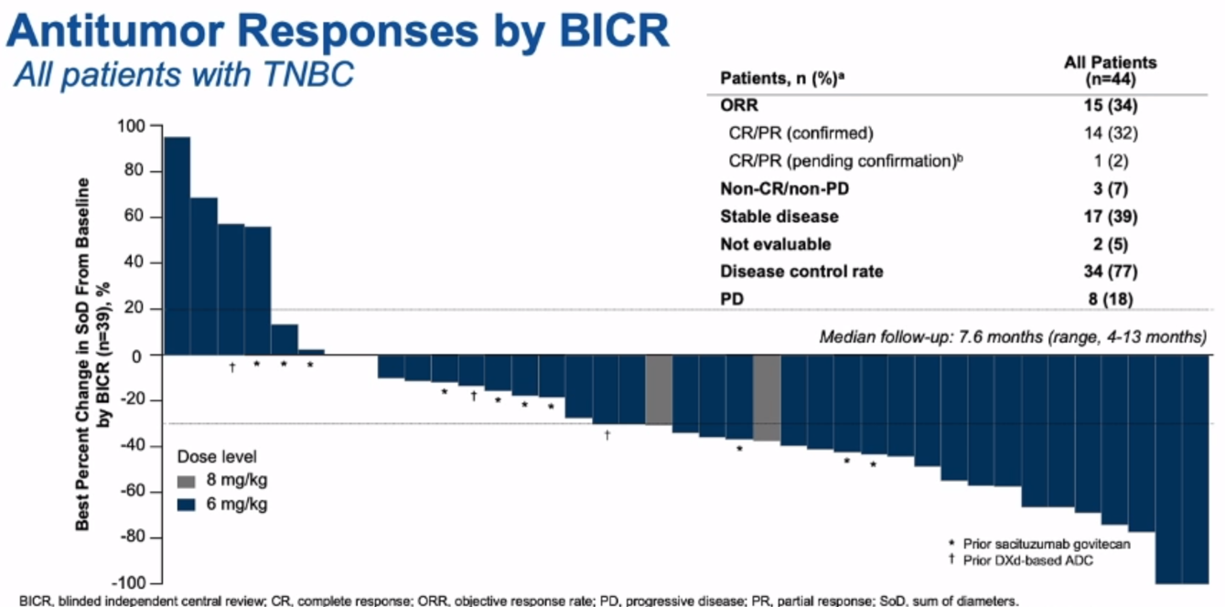
Case 2 – Dato-Dxd response rates in heavily pre-treated TNBC

Slide 56
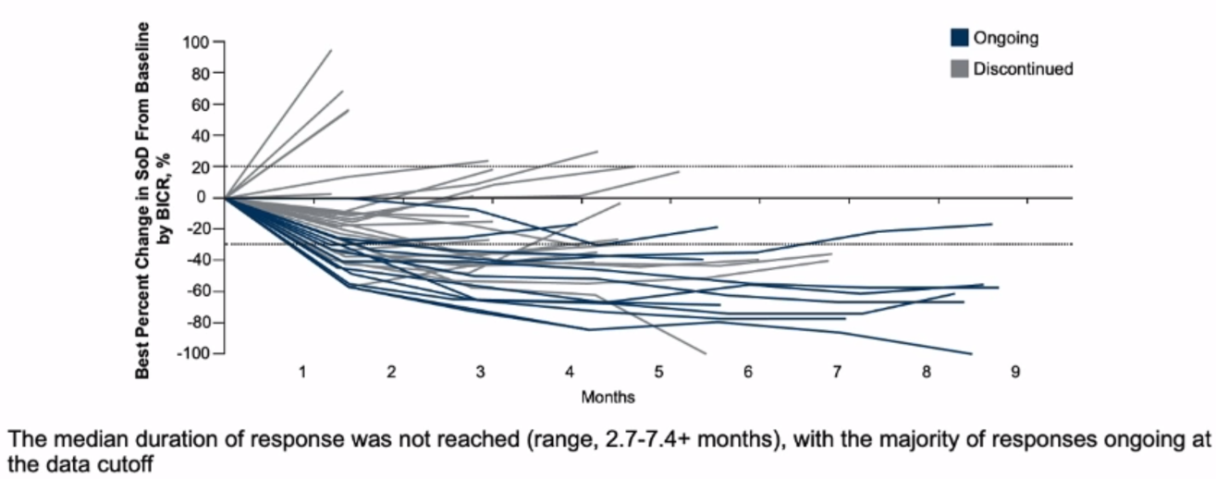
Case 2 – Dato-Dxd duration of response

Slide 57
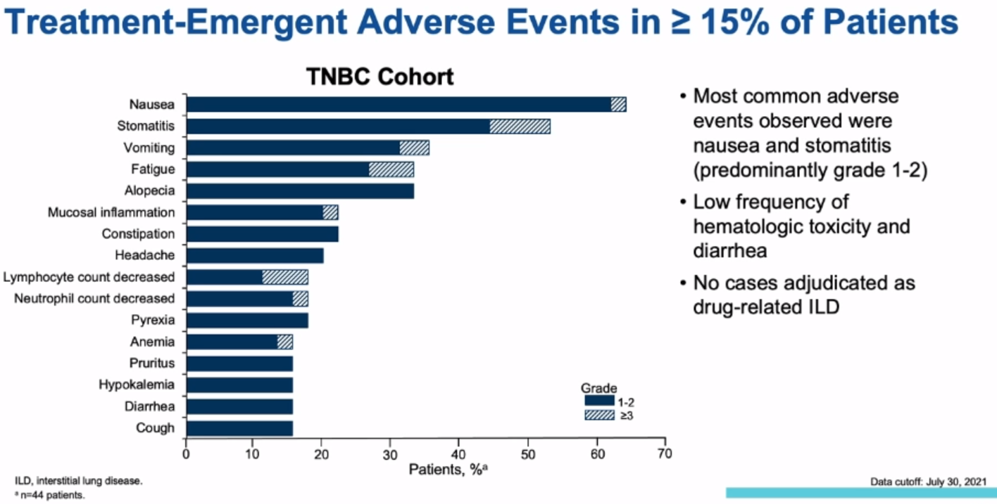

Case 2 – Dato-Dxd Treatment Adverse Events (those found in $≥15\%$ patients)

Slide 58
Case 1 – Scenario 2 – Metastatic recurrence again (previous PD-L1 tx)
Remember Ms. Smith…
14 months later, she developed bone pain and abdominal discomfort
CT and bone scan showed extensive bone and liver metastases
Liver biopsy confirmed mTNBC
Radiation oncologist gave palliative radiation to spine and hip for pain and to reduce fracture risk
Started on zoledronate i.v. every 4 weeks to reduce bone complications (fracture, spinal cord compression, high calcium)
Pembrolizumab
+
Chemotherapy
RCB-3
Pembrolizumab + capecitabine
(6 mo)
Surgery

Slide 59
Case 1 – Scenario 2 – What to do for 1L treatment if already had immunotherapy before?
Medical oncologist presented the following options:
  Try one line of chemotherapy, and then opt for Sacituzumab govitecan if chemotherapy stops working
  Clinical trial
    Access approved antibody-drug conjugates (Sacituzumab) +/- immunotherapy sooner
    Access new (not yet fully proven, but promising) antibody-drug conjugates (e.g., Dato-Dxd) +/- immunotherapy
    Guide TNBC therapy by molecular subtype

Slide 60
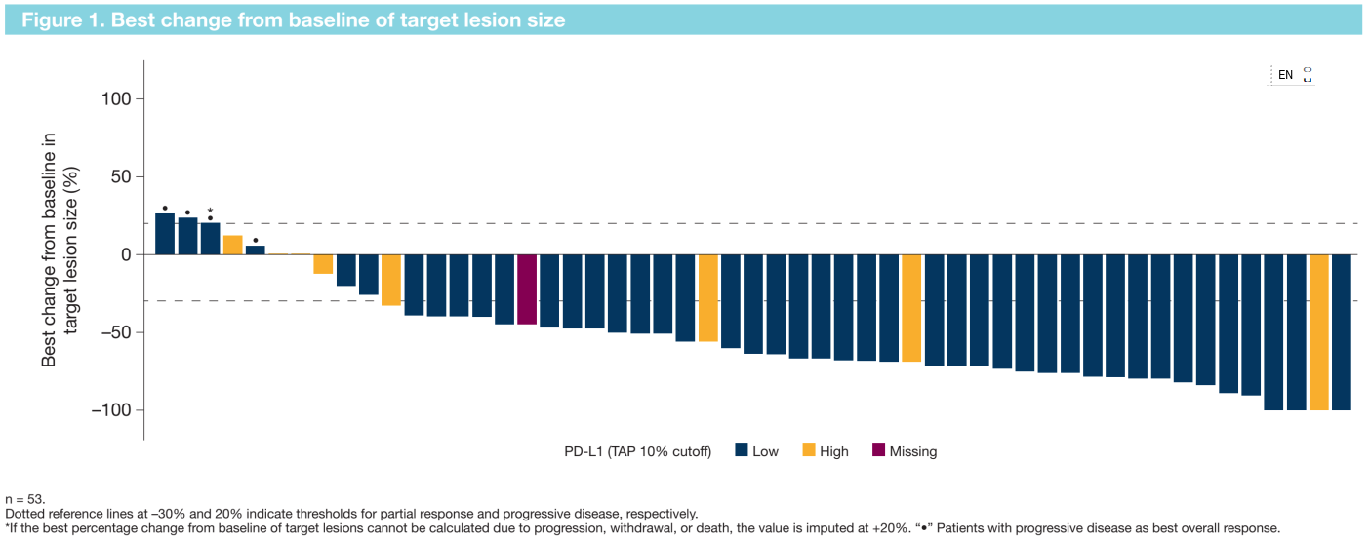
Activity of Dato-Dxd + immunotherapy
 | Dato-Dxd + durvalumab | Chemo + pembrolizumab (PD-L1 ≥ 10%)
ORR | 73.6% | 52.7%

Slide 61
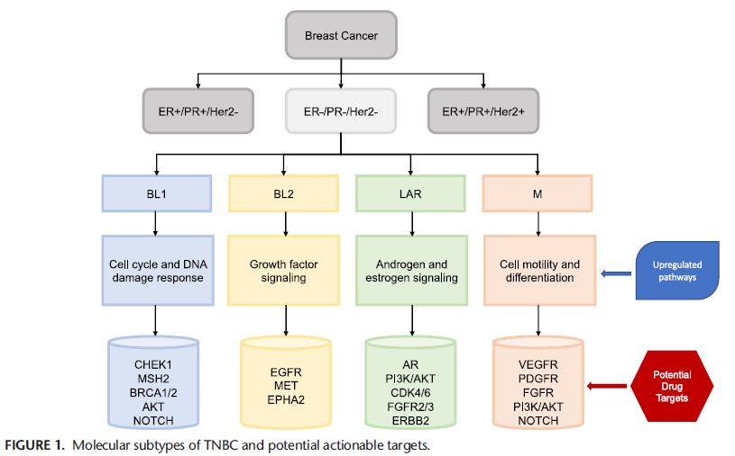
All TNBC are not the same. Molecular subtypes and potential therapy targets
Nunnery SE, Mayer IA, Balko JM. The CA Journal. 2021

Slide 62
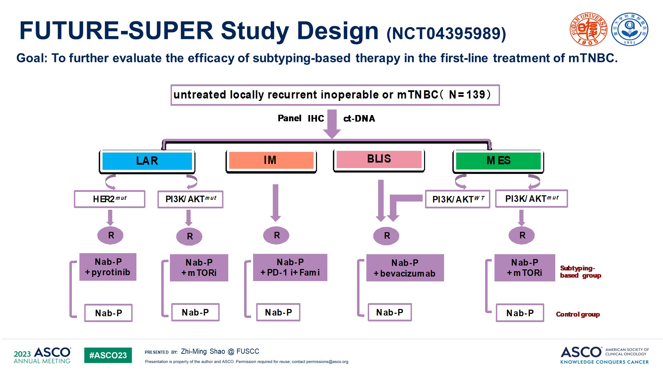
FUTURE-SUPER Study Design (NCT04395989)
N=3
N=18
N=59
N=58
(see LAR PI3K/AKTmut for sample size)
Current 1L SOC pembrolizumab + chemo in PD-L1 CPS ≥ 10% patients
Shao, Zhi-Ming et al. ASCO 2023

Slide 63
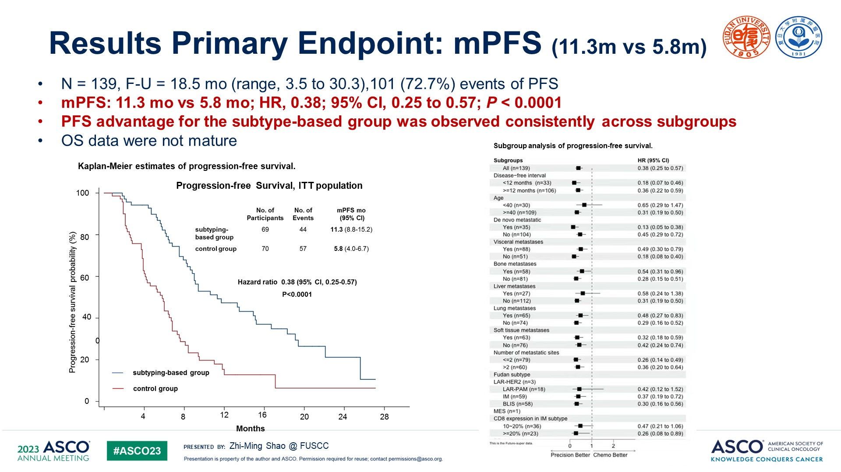
Slide 6
Content of this presentation is the property of the author, licensed by ASCO. Permission required for reuse.

Slide 64
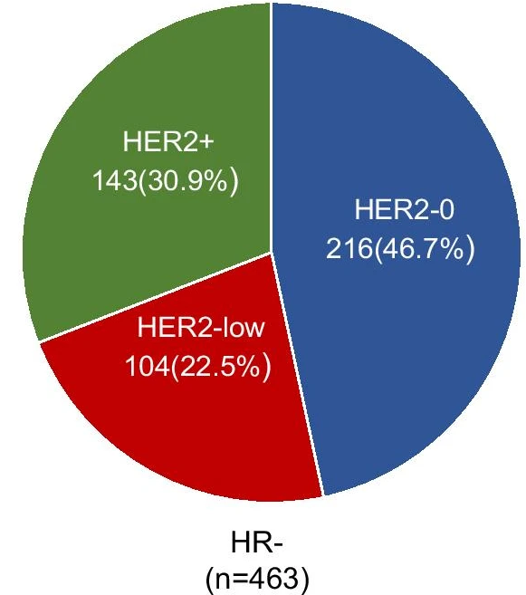
What about HER-2 “low” TNBC?
Up to 50% of breast cancers can have HER-2 low status (including ER+ and ER- breast cancers)
In this Austrian study, 32.5% (104/320) of TNBC considered HER-2 low!
Gampenrieder SP et al. Breast Cancer Research. 2021.

Slide 65
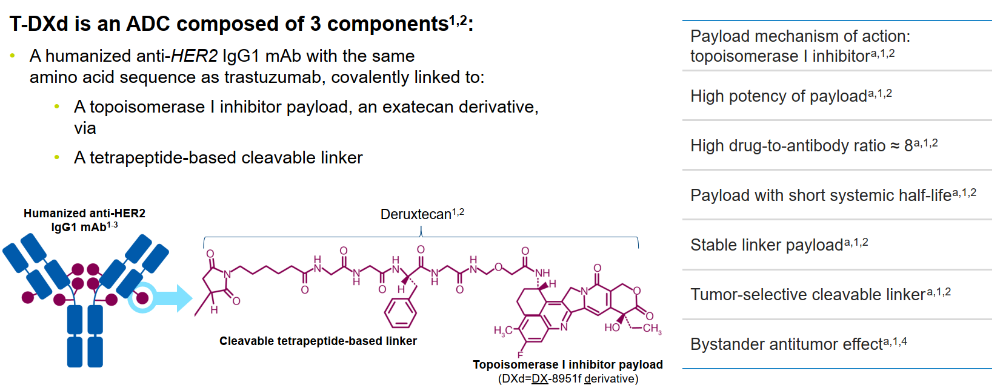
Trastuzumab-Dxd delivers chemo to HER-2 expressing cells

Slide 66
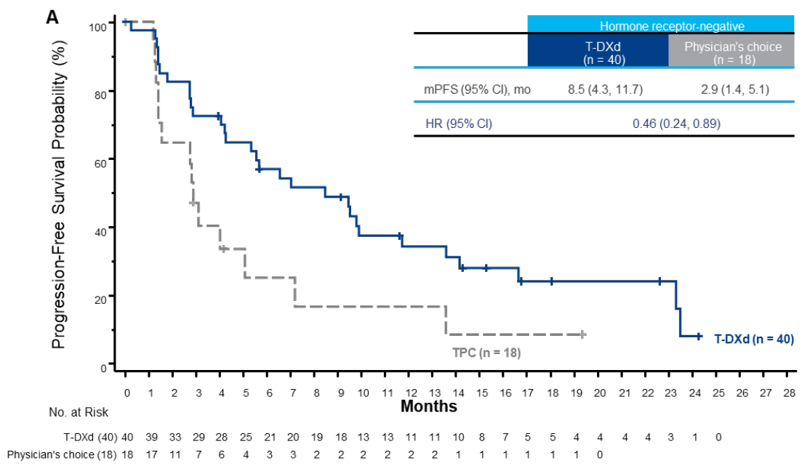
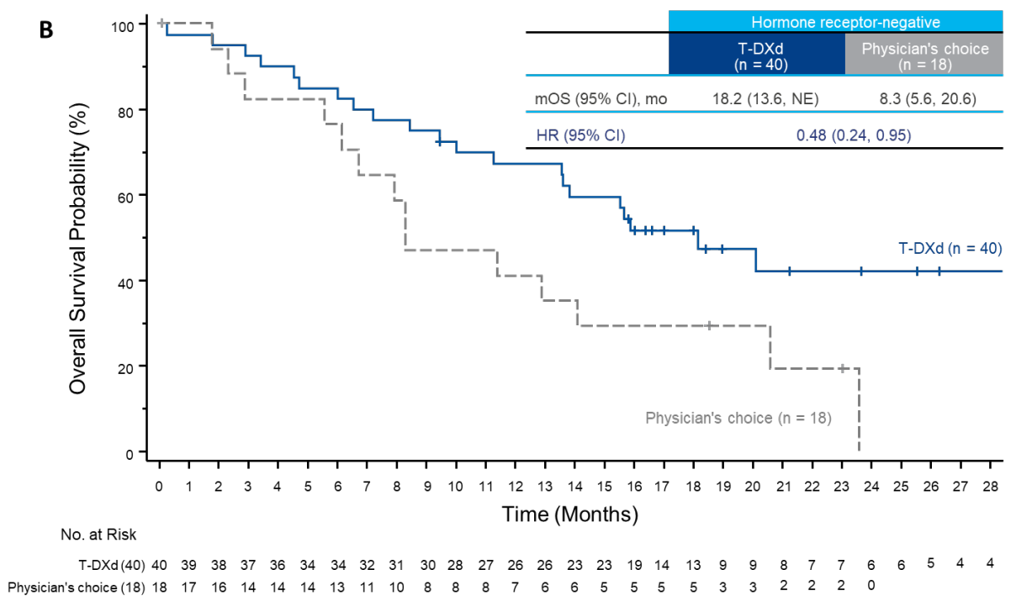
Activity of Trastuzumab-Dxd (T-Dxd) in HER-low TNBC

Slide 67
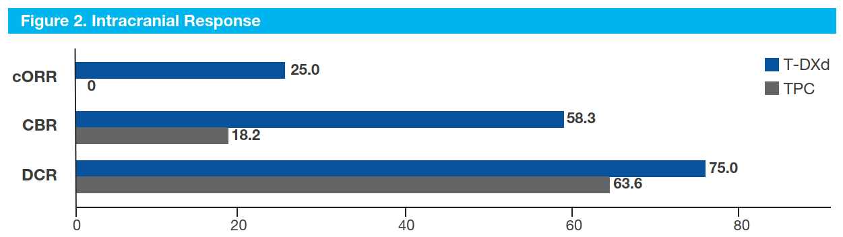
T-Dxd has promising activity against asymptomatic brain metastases
Tsurutani J et al. ESMO 2023. Abs 388P

Slide 68
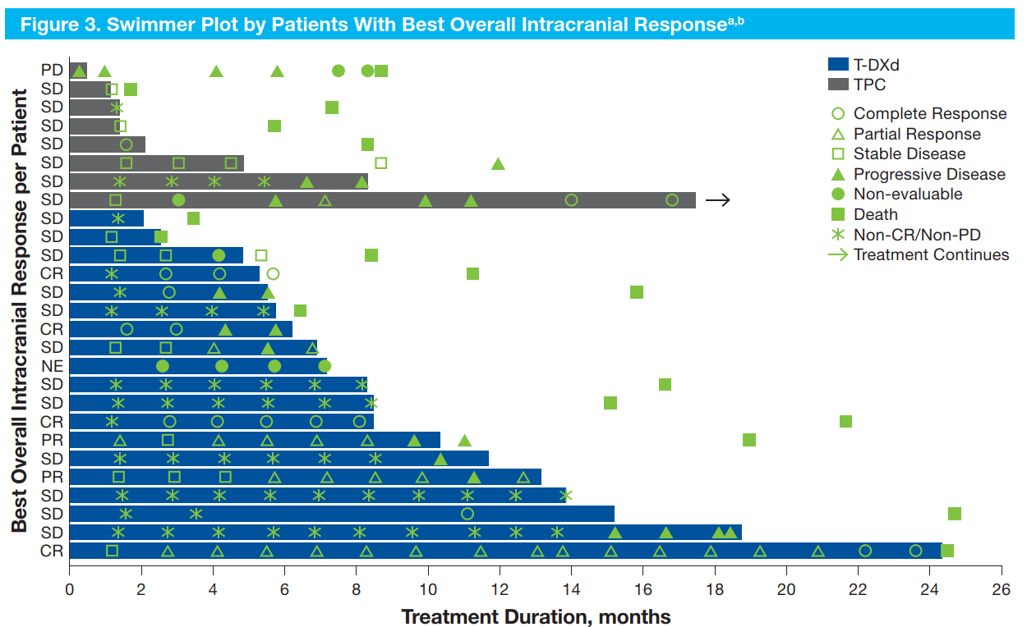
T-Dxd has promising activity against asymptomatic brain metastases
Tsurutani J et al. ESMO 2023. Abs 388P

Slide 69
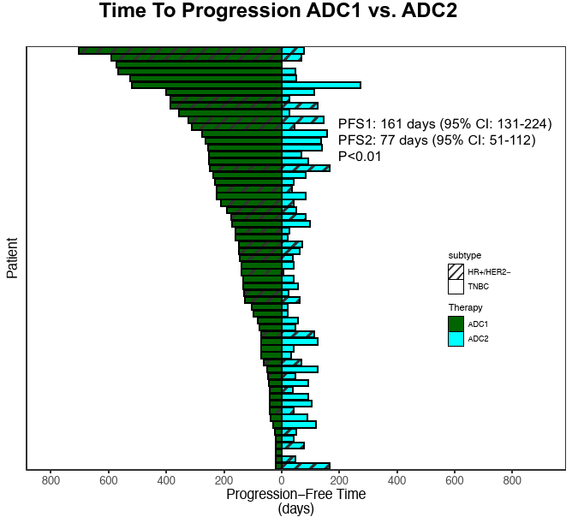
Can patients benefit from Antibody-Drug Conjugate (ADC) after prior ADC?
Definitely some cross-resistance even if different target and payload
Abelman RO et al. SABCS 2023

Slide 70
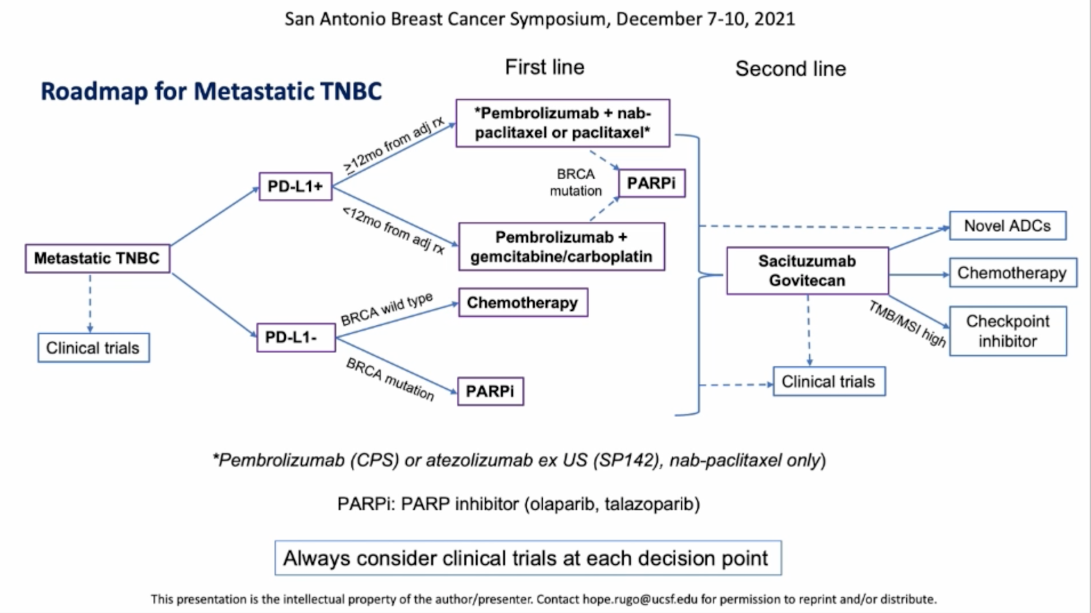
Metastatic TNBC algorithm

Slide 71
Questions?
Thanks to CBCN for the opportunity to speak
Thank you for your attention!

